Slide 1
Summary
Problem/Hypothesis
How
High-level conclusion

Slide 2
Background
Other studies on gentrification
Stage Theory
People, Policy, Place
Model neighborhoods

Slide 3
Emmy
What is our model?
Weighted
Ranking
our approach
construct an accurate snapshot of NYC neighborhoods
develop

Slide 4
Emmy
the variables
people
place
policy
income & crime
sales & development
opportunity zone

Slide 5
Michana
Data Exploration
Income – IRS
- year,s
Sales –
Dev
A

Slide 6
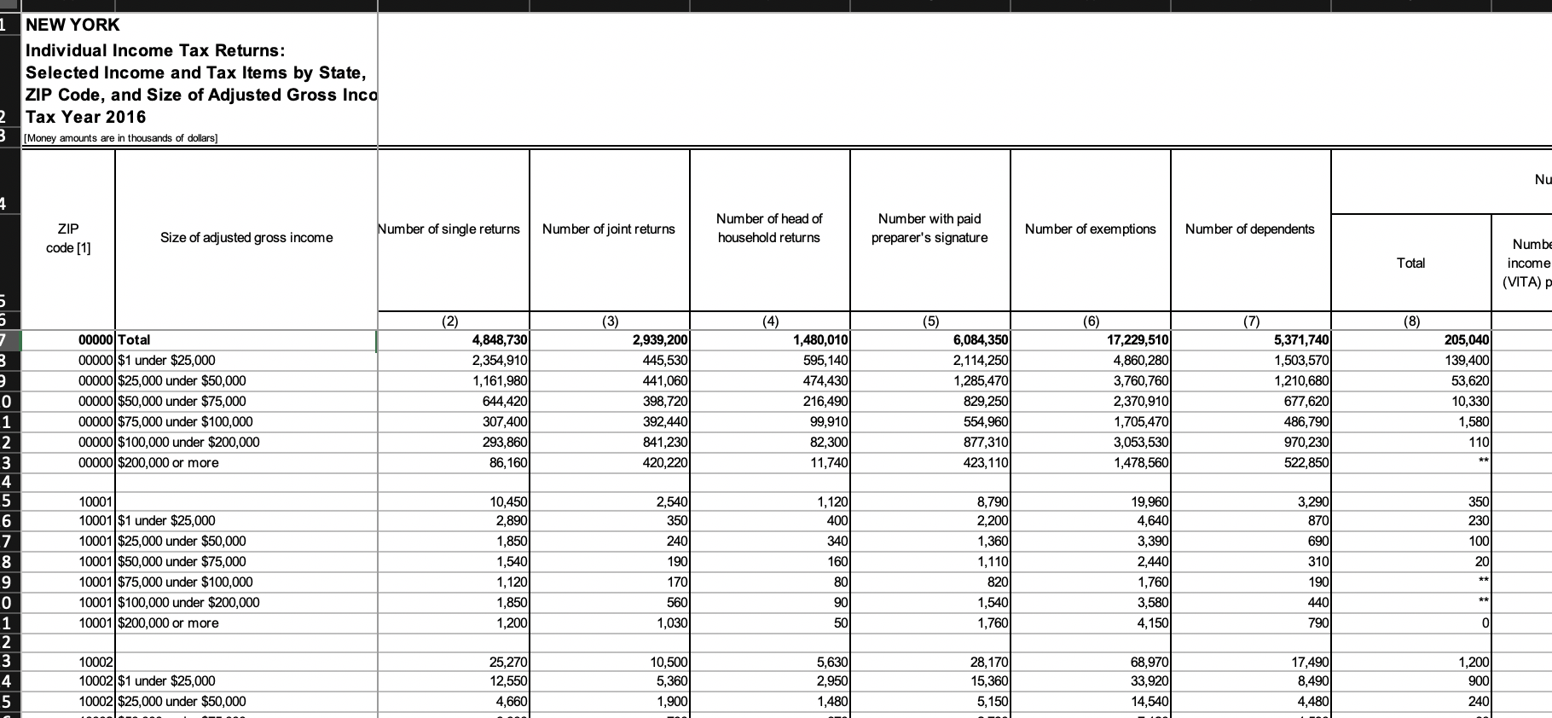
Crime - Michana
Data Clean Up
Before and After
Tell the transformation story

Slide 7
Sales and Dev - Emmy
Data Clean Up
Before and After
Tell the transformation story

Slide 8
JC - Income
Data Clean Up
Before and After
Tell the transformation story

Slide 9
???
Coding for Model

Slide 10
All
Dashboard

Slide 11
All – but one slide
Hypothesis
Conclusion

Slide 12
JC
Limitations
Recommendations

Slide 13
Q&A

